Slide 1
“Predicting whether People tend to opt for Loans over Discounted Rates” IPBA4 GROUP4
Chandrika Malviya Mazhar Mumbaiwala Swarnaprava Ray
Sourabh Patil Sanchit Mittal Shiva Kalyan Parimi

Slide 2
Business Problem:
A group of customers were given an offer in person that they can get a loan at discounted rate and processing fee will be waived off. A pilot campaign was conducted to get response from customers whether they are interested in taking out a loan or not. Response was recorded and data was collected. Based on data given we need to:
Build a model to predict whether customers will be interested in taking out a loan or not.
Identifying features which are most important
In case of black box models e.g. Random forest use SHAP, LIME to figure out features affecting the target variable.
Approaching a customer has costs involved with it, hence find the profitable segments so that more customized marketing can be done.
Model will be needed on a monthly basis as this data gets updated each month.

Slide 3




PPT FLOW
Business Problem Analysis
Approach
Analysis
Pre-Visualizations, Dashboarding & Story Telling

Slide 4
WEEKLY PROGRESS
Week 1: Data Preparation and Pre-visualizations
Week 2: Feature engineering & Feature Extraction
Week 3: Tableau dashboarding and Data Understanding
Week 4: Model Development & Training
Week 5: Model Deployment & Testing
Week 6: Model Tuning
Week 7: Code to Live Environment
Week 8: Final Testing
Week 9: Tableau Story Telling & Presentation

Slide 5
Data Attributes
Important Feature Attributes;
Occupation
No of Credit transaction
SCR
Holding period
Attributes given in Data Set;
Customer ID
Age
Gender
Balance
Occupation
No of Credit transaction
SCR
Holding period

Slide 6
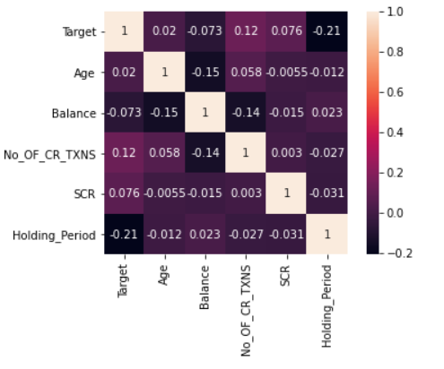
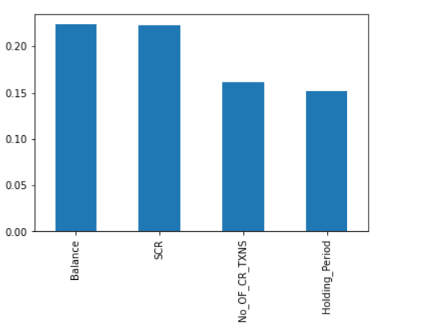
Approach Formulation
In order to see the Customers Turn-in for a loan, most prominent attributes involved were; SCR, Holding Period, Occupation, No of Credit Transactions that were concluded after performing Feature Engineering and feature extraction on the data given.

Slide 7
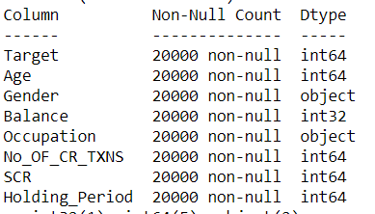
Data Preparation
1. Data Preparation
Importing important libraries
Reading data –
Checked data types. Gender and Occupation are categorical variables stored as object type. Balance is stored as float type. Converted float type to integer type for Balance variable.
Checked null value and found there are no null values in the dataset. Null value treatment is not required.

Slide 8
Exploratory Data Analysis
2. Exploratory Data Analysis –
Correlation-
TARGET showed maximum correlation w.r.to No of Credit transaction among other variables. So remaining correlations have to be visualized in order to understand if there's any sort of trend in data.
Pair Plot – Insights
People who tend to opt for loan have less BALANCE w.r.to people not interested to take loan.
People having higher BALANCE tend to be in between 35-50 years of AGE.
People having less BALANCE tend to show more interest towards loans i.e. higher SCR values.
People having less BALANCE tend to have higher No of Credit transactions opt for loans.
People having less BALANCE have higher HOLDING PERIOD who opt for loans.

Slide 9
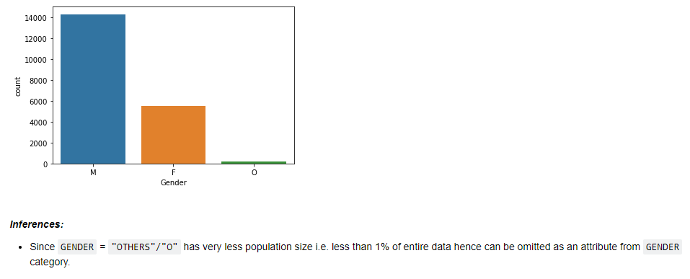
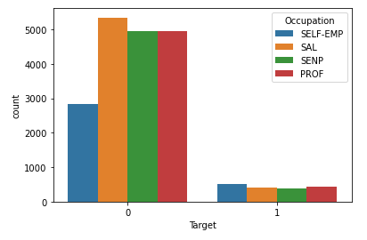
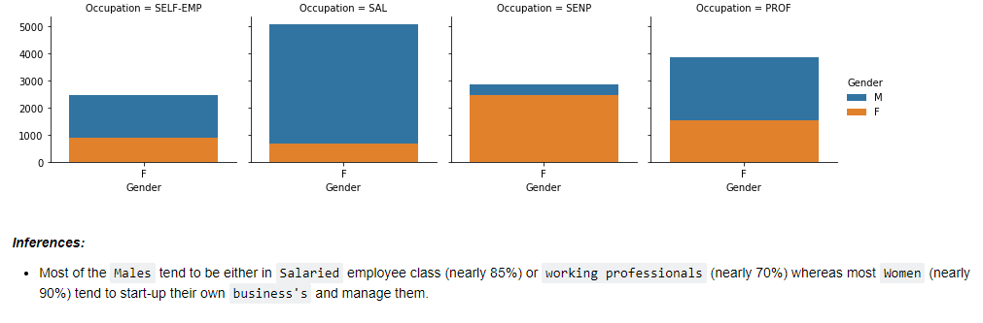

Slide 10
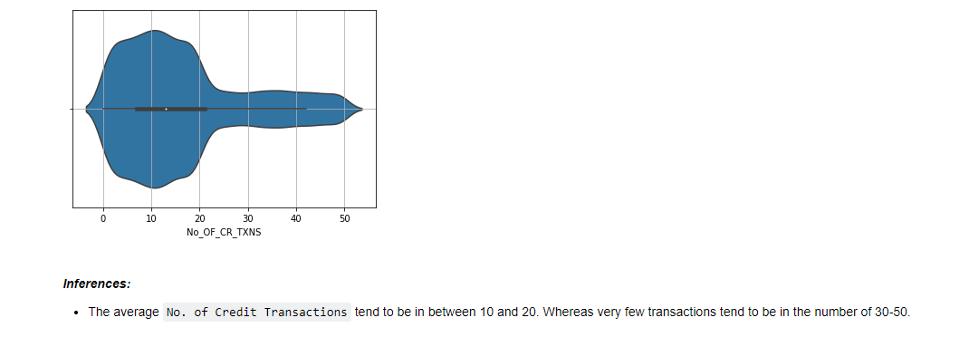
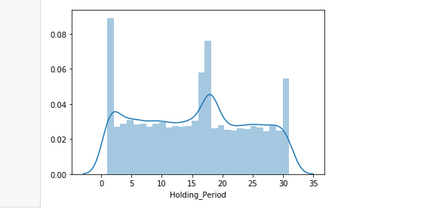
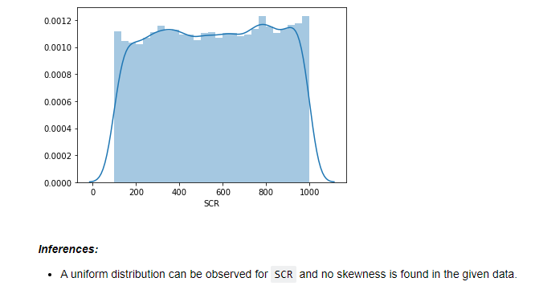

Slide 11
3. Model Building -
Data Preparation- Integrity check, Train/Test Split Random Sampling etc
Imbalanced Data: Developed model for original, undersampling and oversampling data and compared results.
Created undersampled data using nearmiss() and oversampled data using SMOTE().
Developed model using different Machine Learning algorithms like Decision Tree Classifier, SVM Classifier, KNN Classifier, Random Forest Classifier, Logistic Regression.
Found out important features from Random Forest Classifier,Logistic Regression as: SCR, Balance, No. of Credit Transactions and Holding Period.

Slide 12
Model Evaluation
ML Algorithm | Sensitivity Percent% | Comments
DecisionTreeClassifier - Original Data | 10.9 | Not Considering
DecisionTreeClassifier - UnderSampled Data | 9.84 | Not Considering
DecisionTreeClassifier - OverSampled Data | 19.6 | Not Considering
KNN Classifier - Original Data | 17.2 | Not Considering
KNN Classifier - Under sampled Data | 8.6 | Not Considering
KNN Classifier - Oversampled Data | 17.2 | Not Considering
Random Forest Classifier - Original Data | 18.4 | Not Considering
Random Forest Classifier - Oversampled Data | 25.0 | Considering
Logistic Regression - Under sampled Data | 16.4 | Not Considering
Logistic Regression – Normalized Oversampled | 21.96 | Considering
Logistic Regression - Oversampled Data | 20.8 | Considering
Random Forest Classifier - Under sampled Data | 11.4 | Not Considering

Slide 13
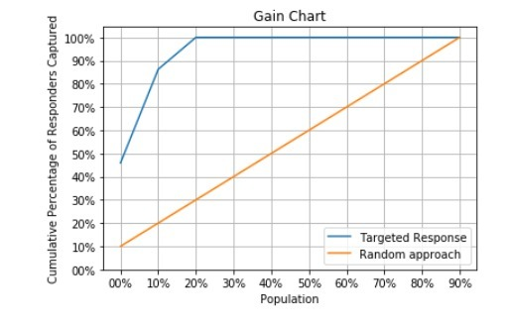
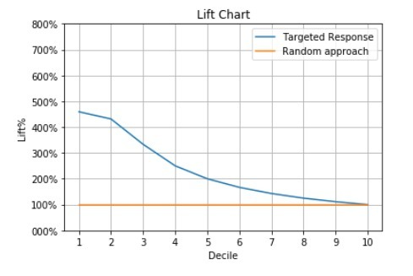
Best Model KS-Stats

Slide 14
K-S Statistics & Lift Chart Inferences
RF undersample: KS table shows KS is max at 3rd Decile. It represents 71% cumulative responders for loan. Max lift is 2.6. Out of 516 people, 52 people will respond to loan. Response rate is 10. But lift is low i.e 1.8. So it is not a profitable approach.
RF oversample: KS table shows KS is max at 2nd Decile. It represents 100% cumulative responders for loan. Lift is 5.09.Max lift is 8.5. Out of 485 people, 27 people will respond to loan. Response rate is very less i.e 5.6. So not a profitable approach.
LR undersample: KS table shows KS is max at 4th Decile. It represents 96.4% cumulative responders for loan. Lift is 2.4.Max lift is 2.7. Out of 495 people, 59 people will respond to loan. Response rate is 11.9. So it is a profitable approach.
LR oversample: KS table shows KS is max at 3rd Decile. It represents 93.5% cumulative responders for loan. Lift is 3.1.Max lift is 4.2. Out of 495 people, 58 people will respond to loan. Response rate is 11.7. So it is a profitable approach.
A higher lift and higher response rate indicates a better model. So LR oversample is a better model .

Slide 15
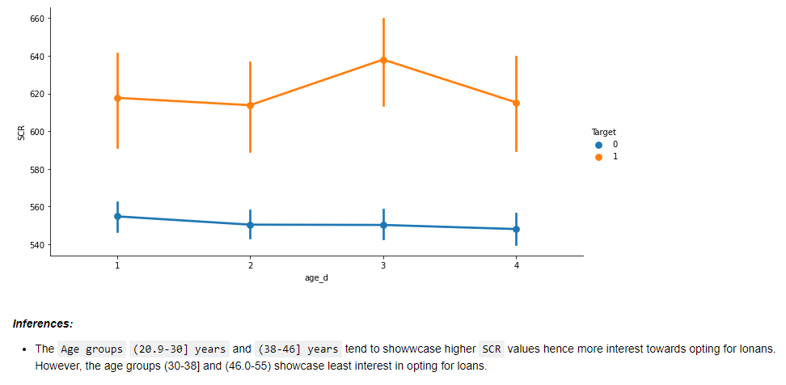
Post Bucketing Visualization

Slide 16
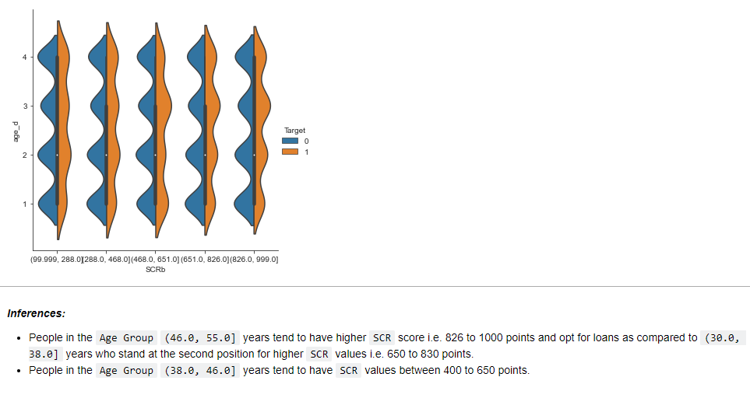

Slide 17
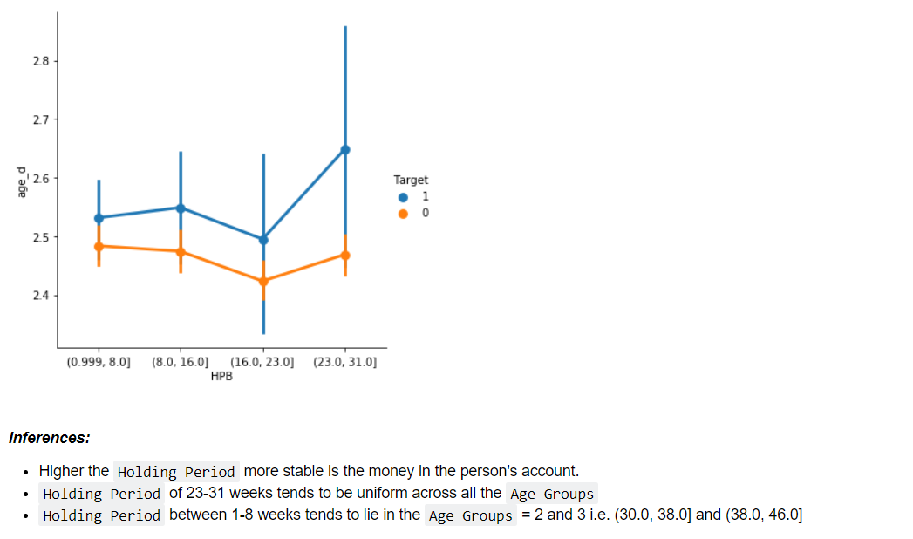

Slide 18
4. Observations
B. Post Bucketing Visualization
Observations on Bucketed Data
People who tend to opt for loan have less Balance w.r.to people not buying loan.
People having higher Balance tend to be in between 35-50 years of Age.
People having less Balance tend to show more interest towards loans i.e. higher SCR values.
People having less Balance tend to have higher No of Credit Transactions opt for loans.
People having less Balance have higher Holding Period who opt for loans.

Slide 19
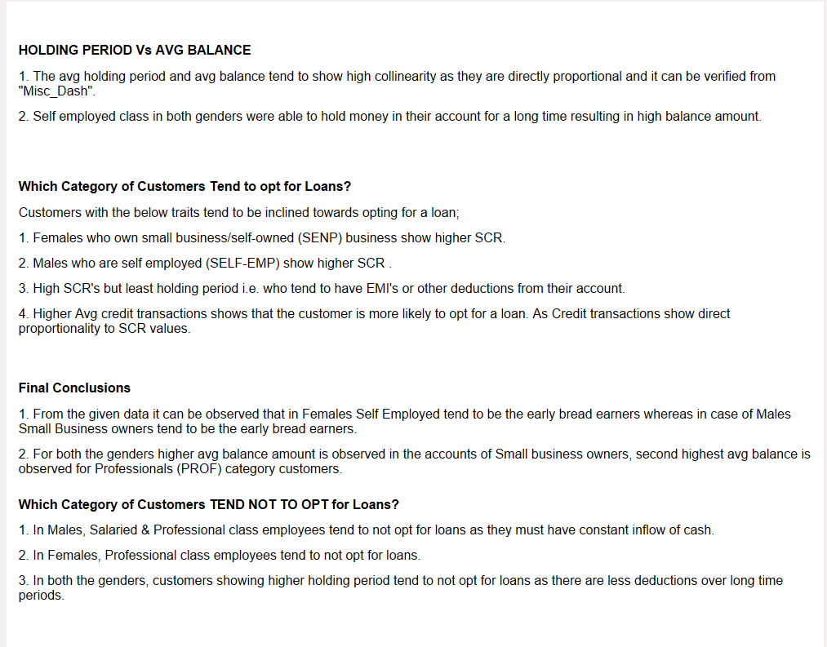
Conclusion

